Slide 1
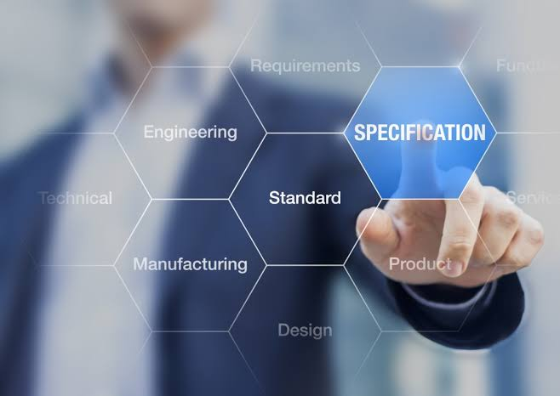
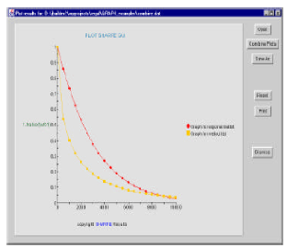
Performance Modelling View
Model Validator
UML
Collaboration & activity diagram
Performance SRN Model
Deployment Phase
Performability SRN model
Model
Annotation phase
Model
Transformation phase
Model synchronization using Guard functions
Performability evaluation
Phase for State machine generation
Dependability SRN model
Model Validator
Dependability Modelling View
Legend: ....... manual
Flow of operation Model validation activity Figure 1. Performability modeling framework

